Slide 1



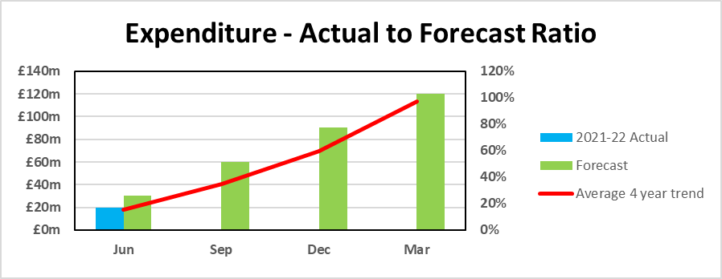

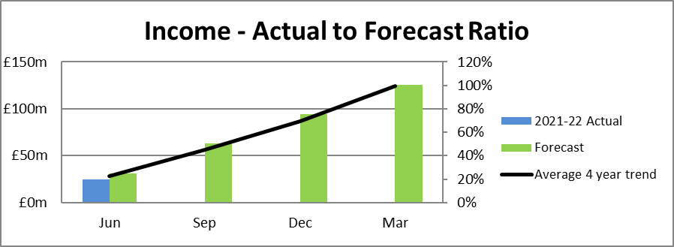


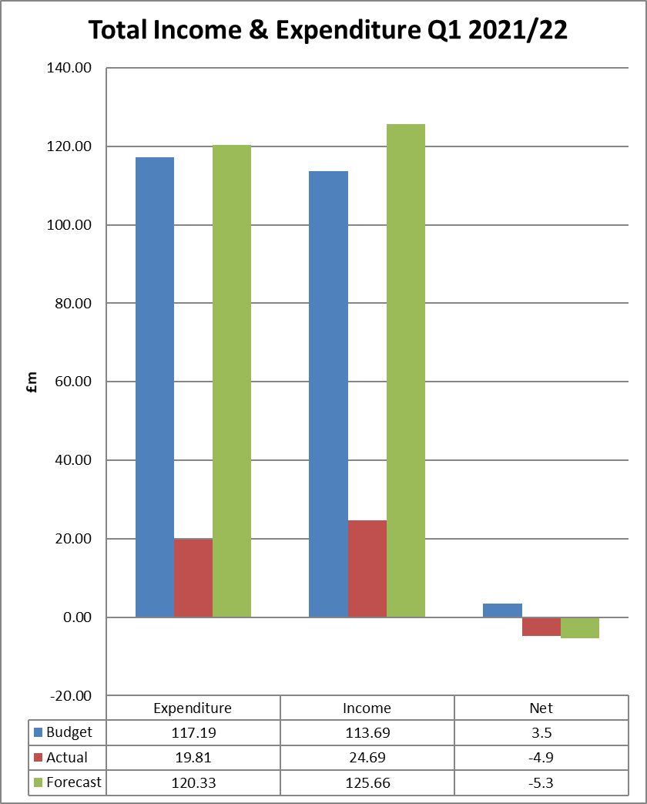

Corporate Performance Dashboard 2020/21 Q2
Corporate Performance
  Dashboard 2021/22
Q1
Q1
Corporate Outcome | Key Performance Indicators | Target | RAG | Status
 | Volume of timber brought to the market | 3.2 m³ obs
 | Area of land awaiting restocking | Reduce from 20/21 figure
 | Area of woodland creation | 650 ha
 | Area of high conservation value forests and land | Maintain 20/21 area
 | Cumulative total area of Peatland with initial restoration action | Increase by 10%
 | % of Notified Features on Designated sites in favourable (or unfavourable recovering) Condition | 94%
 | Maintain UKWAS Certification | Maintain
 | Number of community groups engaged in recognised partnerships and agreements | 90
 | Visitor Centre Net Promotor Score | 70 NPS
 | Percentage of women/females in senior roles (SCS –PB4) | 10%
 | Ratio of near miss reporting to total accidents and incidents reported | 20%
 | Staff Engagement: Percentage of employees who would recommend FLS as a great place to work | 65%
 | Average number of working days lost per FTE | 9.5 days
 | % of requests for information (FOI) processed on time (within 20 working days of receipt of the request) | 95%
 | % of Ministerial and Corporate Correspondence System (MACCS) queries responded to within agreed timescales | 95%
 | % of complaints closed at frontline resolution stage | 80%
Finance
Risk
The top risks identified in the Risk Register in Q1 are as follows:
Health and Safety: This remains a particularly serious concern for FLS due to the incidence rate within forestry.
Financial Sustainability: Work is ongoing to adopt new ways of working to deliver against our Business Sustainability actions, including achieving a balanced budget for FY 21/22 to reflect income, expenditure and funding pressures. Regulatory Compliance: Work continues to raise awareness of and to ensure regulatory compliance across the organisation through embedding the Assurance Framework.
Organisational Capacity: Work continues to understand and catalogue business impacts that are creating "pressures points" on business areas.
Complexity of Change: There are a number of risks rolled into this arising from the amount and complexity of change including; organisational change; the FLS change programmes; Covid-19 recovery, impending Brexit impacts and the introduction of new legislation and regulations

Slide 2
Corporate Dashboard slide 2
COVID-19 Impacts
Our People
999 FLS Employees (at end of June 2021)
Recruitment – Right to work checks continue to be carried out digitally. This was due to end on 1 September 2021 and face to face checks were to return, but has now been extended to 5 April 2022 and is likely to continue as central government explores digital solutions to replace in person checks.
The main impact of Covid-19 is on the ability of staff to engage effectively in creative problem solving; this, together with the constraints on travelling and meeting on sites, remains a barrier to the development of strategic projects and to solving some of the more complex management problems faced.
Restrictions around vehicle sharing continue to put pressure on the vehicle fleet and mean reduced efficiency from people traveling in separate vehicles as well as additional costs incurred due to having to provide additional vehicles and COVID-19 equipment to colleagues.
The marketing of key properties has been delayed. The estates development department are currently working through a backlog of land sales/community transfers as a result of Covid -19 restrictions.
All Corporate Services staff continue to work from home. The national lockdowns over the quarter have placed additional stresses on the team, particularly on those with caring and/or home-schooling responsibilities. Where possible work has been prioritised or pushed back.
Covid – 19 recovery continues to be a core focus throughout the regions with staff evolving their skills in relation to technology and other more dynamic and innovative ways of working to maximise communication and IT based work streams.
Business Services | 219.80
Corporate Services | 14.87
Estate Development | 13.46
Land Management | 715.73
Total | 1002
Comments: There has been a further increase in staffing numbers since March 2021. Measures are being developed by Finance and HR to create establishment levels and explore methods to control staffing growth.
Accidents & Incidents
Type | 20/21 Total | 21/22 Q1 | 21/22 Q2 | 21/22 Q3 | 21/22 Q4 | 21/22 Total
Employee accidents (Non-RIDDOR) | 23 | 6
Employee accidents (RIDDOR) | 5 | 0
Contractor accidents (Non-RIDDOR) | 6 | 2
Contractor accidents (RIDDOR) | 1 | 0
Agency accidents (Non-RIDDOR) | 0 | 0
Agency accidents (RIDDOR) | 0 | 0
Number of incidents (non-RIDDOR) | 707 | 180
Number of incidents (RIDDOR) | 5 | 3
Member of public accidents (non-RIDDOR) | 26 | 3
Member of public accidents (RIDDOR) | 0 | 0
Q1 Issues & Achievements
Successful launch of the Executive Team (ET) Gateway Approval Request process, Change and Investment Board, Investment Strategy and associated guidance/processes
An additional £30M over 5 years of SG funding for land acquisition and planting has been secured.
The agency has signed up to the woodland carbon code
The replacement recruitment system has been launched as a module in iTrent, improving the recruitment process for candidates and hiring managers.
SG Internal Audit completed an IT Cyber-Security Audit on FLS in Q1 which reported Reasonable Assurance which is a very good result with the current heightened cyber threat and surrounding scrutiny following a very high-profile attack last year. The Digital Services team have already commenced work on recommended actions
Health surveillance is behind schedule. Whilst work is being undertaken with our current provider to rectify this, the procurement of a new contract and the addition of a Health Safety and Wellbeing Coordinator post are future improvements that will help ensure that this gets back on track.
Accident & Incident Learnings:
The most common cause of employee injury this quarter was slips, trips and falls, all of which occurred outside. All work-related ill-health reports (6) were tick-related in Q1 21/22, compared with 2 (of 3) in the same quarter last year.
Over half of all the health and safety incidents reported on AIRS related to activities involving members of the public. These included:
• unauthorised access/ ignoring signs (pedestrians, motorbikes/ quads, camping, large gatherings)
• damage e.g. gates, locks, fences
• theft e.g. diesel, quad bike
• illegal felling
• fires
• verbal abuse
• fly tipping and human waste
An increased number of checks are being carried out on visitor safety in operations by Regions, along with an audit by the Health Safety and Wellbeing Team.
Key to symbols
Supporting a Sustainable Rural Economy
Looking after Scotland’s National Forests and Land
Scotland’s National Forests and Land for Visitors and Communities
A Supportive, Safe and Inclusive Organisation
A High Performing Organisation
More detailed information can be found in the accompanying Q1 Corporate Performance Report.
Corporate Performance Dashboard 2021/22
Q1

