Slide 1



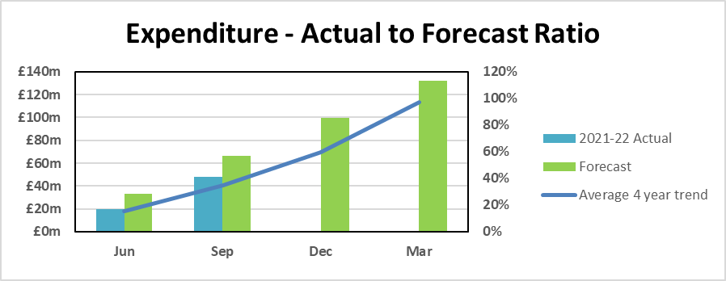

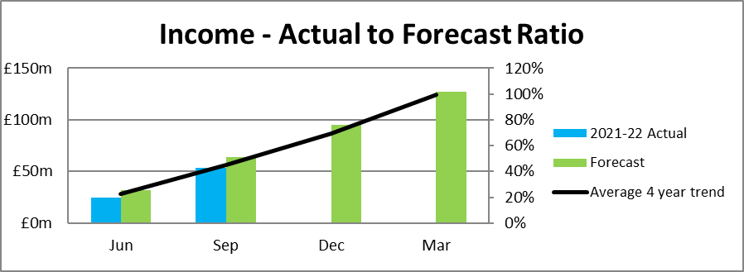


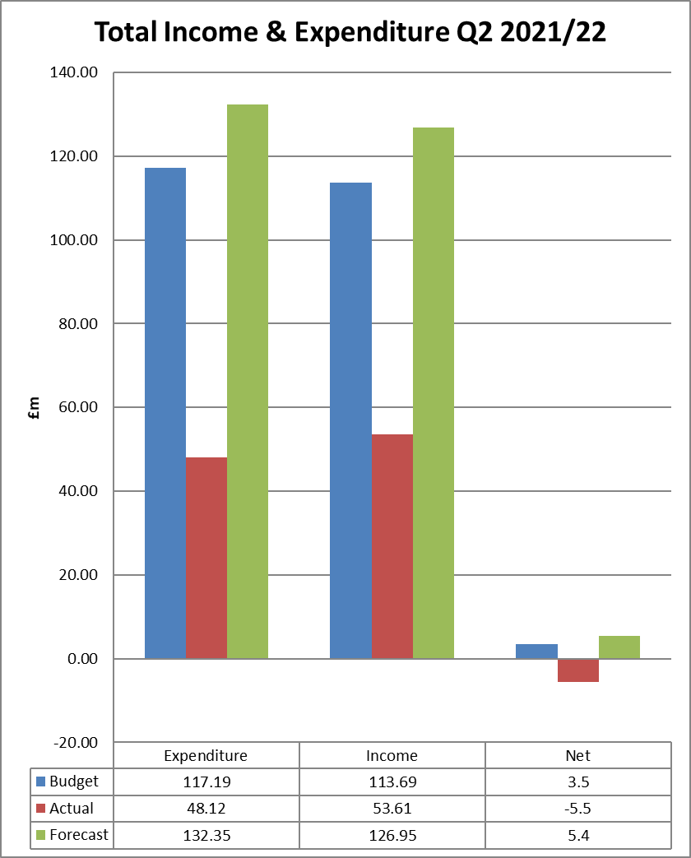

Corporate Performance Dashboard 2020/21 Q2
Corporate Performance
  Dashboard 2021/22
Q2
Q1
Corporate Outcome | Key Performance Indicators | Target | RAG | Status
 | Volume of timber brought to the market | 3.2 m³ obs
 | Area of land awaiting restocking | Reduce from 20/21 figure
 | Area of woodland creation | 650 ha
 | Area of high conservation value forests and land | Maintain 20/21 area
 | Cumulative total area of Peatland with initial restoration action | Increase by 10%
 | % of Notified Features on Designated sites in favourable (or unfavourable recovering) Condition | 94%
 | Maintain UKWAS Certification | Maintain
 | Number of community groups engaged in recognised partnerships and agreements | 90
 | Visitor Centre Net Promotor Score | 70 NPS
 | Percentage of women/females in senior roles (SCS –PB4) | 40%
 | Ratio of near miss reporting to total accidents and incidents reported | 20%
 | Staff Engagement: Percentage of employees who would recommend FLS as a great place to work | 70%
 | Average number of working days lost per FTE | 9 days
 | % of requests for information (FOI) processed on time (within 20 working days of receipt of the request) | 95%
 | % of Ministerial and Corporate Correspondence System (MACCS) queries responded to within agreed timescales | 95%
 | % of complaints closed at frontline resolution stage | 80%
Finance
Risk
The top risks identified in the Risk Register in Q2 are as follows:
Health and Safety: The main risk remains as occupational disease, serious accident or loss of life relating to an employee, contractor or member of the public
Financial Sustainability: Financial pressures across Scottish Government remains significant, particularly in relation to supporting the Scottish economy to recover from Covid-19 impacts and ongoing uncertainties including Brexit. There is also increasing emerging risk from liabilities with managing the national forests and land relating to staff, contractors and members of the public.
Regulatory Compliance: Work continues to raise awareness of and to ensure regulatory compliance across the organisation via embedding the Assurance Framework.
Organisational Capacity: Work continues to understand and catalogue business impacts that are creating "pressures points" on business areas.
Complexity of Change: There are a number of risks rolled into this arising from the amount and complexity of change including; organisational change; the FLS change programmes; Covid-19 recovery, impending Brexit impacts and the introduction of new legislation and regulations. The overall cumulative impact of change will also need to be considered as actions are developed from the “Moving to Business Sustainability” work.
Business Continuity: The outbreak of COVID-19 has significantly increased organisational risk and contingency arrangements were initialised. Response continues in line with recommendations from the NHS and wider Scottish Government, including the new tiered approach affecting local areas.

Slide 2
Corporate Dashboard slide 2
COVID-19 Impacts
Our People
999 FLS Employees (at end of September 2021)
Recruitment - Market reports state that candidates are typically tending to stay with their current employer at present, particularly if they are female. Additionally, the reported and anticipated post-Covid series of redundancies has not happened leading to fewer candidates on the market.
CV-19 restrictions continue to provide headwinds to planning and delivery, with more capacity needed in places to compensate.
Covid-19 absences (for direct infection of employees) have not had a significant impact but following schools re-opening many parents again had additional caring responsibilities as children caught Covid-19 or had repeated isolation periods. Where employees have tested positive there is no evidence of these infections being caught or passed on in the workplace.
Visitor numbers have increased significantly throughout the regions due to increased ‘staycations’ across the country.
As the safe and phased re-opening offices progresses the Regions are beginning to develop and consider smarter working, blended working principles and consolidation of team discussions as part of guidance and support for staff.
Covid – 19 recovery continues to be a core focus throughout the regions with staff evolving their skills in relation to technology and other more dynamic and innovative ways of working to maximise communication and IT based work streams.
Business Services | 232.72
Corporate Services | 14.87
Estate Development | 16.46
Land Management | 736.06
Total | 1000.11
Comments: The increase in Business services staffing is largely due to student placements (16)/apprentices who started work in September. Methods of managing establishment are being developed by Finance and HR in order to control staffing costs.
Accidents & Incidents
Type | 20/21 Total | 21/22 Q1 | 21/22 Q2 | 21/22 Q3 | 21/22 Q4 | 21/22 Total
Employee accidents (Non-RIDDOR) | 23 | 6 | 10
Employee accidents (RIDDOR) | 5 | 0 | 1
Contractor accidents (Non-RIDDOR) | 6 | 2 | 5
Contractor accidents (RIDDOR) | 1 | 0 | 0
Agency accidents (Non-RIDDOR) | 0 | 0 | 0
Agency accidents (RIDDOR) | 0 | 0 | 0
Number of incidents (non-RIDDOR) | 707 | 180 | 0
Number of incidents (RIDDOR) | 5 | 3 | 1
Member of public accidents (non-RIDDOR) | 26 | 3 | 11
Member of public accidents (RIDDOR) | 0 | 0 | 0
Q2 Issues & Achievements
Highlights included a pre-emptive PR announcing the September deer cull which for the first time allowed us to present in full our rationale for the cull to an audience of over 1 million people.
Completion of the Corporate Function Review business case and launch of the consultation with trades unions and staff.
Cairngorms Connect (FLS involved in collaborative partnership) has been awarded the prestigious 'Nature and the Environment Award' at the Holyrood COP26 Green Giant Awards.
Draft FLS Route Map to Net Zero prepared with core components to be included within the organisation’s Climate Change Plan.
Central region won the highly commended Scottish wood award for Balgownie Woods.
Deer Management: Continued and positive progress in relation to population management, improvements to be realised in terms of internal performance and external landscape scale approaches/objectives (predominantly neighbour relationships/positions).
1076 gross ha acquired or under offer for the LCIF
Accident & Incident Learnings:
The RIDDOR incidents were: a slip/trip/fall (over 7 day injury) and a felled tree striking an overhead power line (dangerous occurrence). There were also two RIDDOR occupational ill health reports related to ticks/ Lyme disease.
The top cause of injury to employees was wasp stings. Some incidents reported included multiple people.
The increase in activity related to removal of COVID restrictions and this may be a factor in the rise in injuries e.g. members of the public, but does not fully explain it. Falls from mountain bikes was the highest cause of injury to members of the public.
Key to symbols
Supporting a Sustainable Rural Economy
Looking after Scotland’s National Forests and Land
Scotland’s National Forests and Land for Visitors and Communities
A Supportive, Safe and Inclusive Organisation
A High Performing Organisation
More detailed information can be found in the accompanying Q2 Corporate Performance Report.
Corporate Performance Dashboard 2021/22
Q2

